Slide 1
What is HIV and AIDS?
Do you know the difference?

Slide 2
http://library.thinkquest.org/03oct/01335/

Slide 3
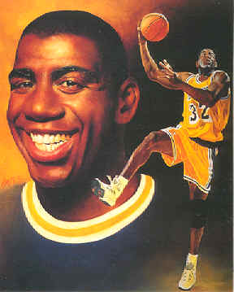
Human Immunodeficiency Virus
Symptoms may occur shortly after being infected
HIV is the first stage of AIDS
Weakens the immune system
Treatment & medication cocktails
can help people manage disease & maintain normal life activities

Slide 4
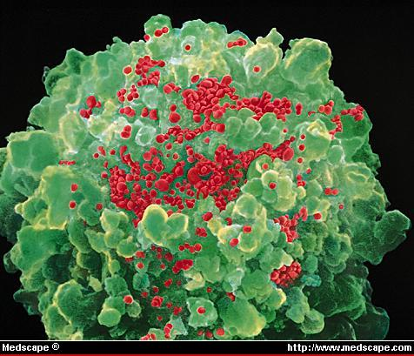
NOT THE SAME Incubation period (2 m-10 years)- Still Spread? AIDS=“full-blown” HIV Virus T-Cell Count (<200)
HIV Stands for…. AIDS Stands for…
A = Acquired
I = Immune
D = Deficiency
S = Syndrome
H = Human
I = Immunodeficiency
V = Virus

Slide 5
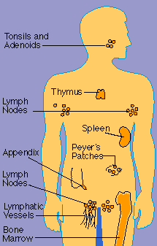
HOW DOES HIV CAUSE DISEASE?
Immune Suppression
It destroys the body’s defense mechanism allowing other infections to invade the body.
OPPORTUNISTIC INFECTIONS

Slide 6
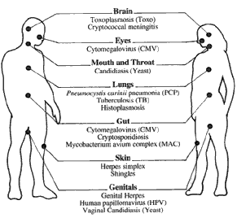

Slide 7
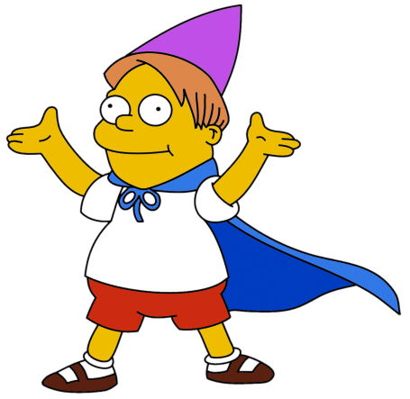
“When it began turning up in children and transfusion recipients, that was a turning point in terms of public perception. Up until then it was entirely a gay epidemic, and it was easy for the average person to say 'So what?' Now everyone could relate.“
Harold Jaffe of the CDC for Newsweek

Slide 8
AIDS / HIV STATISTICS
34,300,000 people in the world have HIV/AIDS!
5,400,000 NEW cases occurred worldwide in 2004!
5 young people, aged 15-24, became infected every minute in 2004!
98% of these people will die from AIDS!

Slide 10
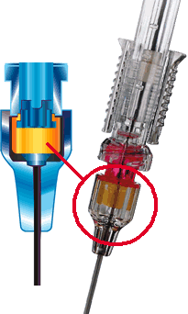
HOW YOU CAN GET HIV
Sexual Contact
Sharing Needles and Syringes
Tattoos and Body Piercing
From mom to baby
Semen, Blood, Vaginal Fluids

Slide 11
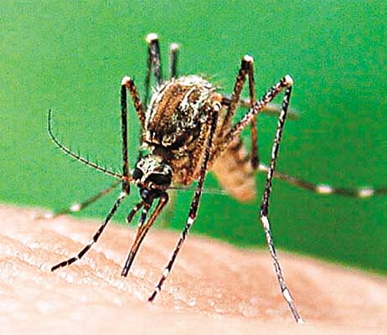
How You DO NOT Get HIV
Sweat, Saliva, Urine (pee) or Tears
Hugging or Touching
Animal / Insect Bites
Donating Blood
Using the same bathroom as someone with AIDS/HIV
Being friends with someone who has AIDS/HIV

Slide 12
PREVENTION STRAGETIES
Plan A: ______________is the only 100% effective method
Communicate limits with your partner
your sexual intentions and limits
Plan B: _______&_________ sex Male are one of the most effective methods for preventing STD’s
Avoid multiple partners or high-risk partners

Slide 13
Essential Questions
How can you tell if someone has an STI?
How is becoming sexually active comparable to the bottles?
How is sexual activity like:
Gambling at the casino boats?
Eating McDonalds
Difference between Viral, Bacterial, Parasitic?
HIV vs. AIDS, Opportunistic, Incubation
Plan A vs. Plan B.

Slide 14
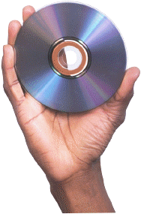
STI Review Activity
Select one STI to represent
Give yourself a creative band name related to your designated STI
Pretend that you have just released a new CD that has 5 songs on it
Come up with different titles for each of the five songs on the CD
The song titles should have a statement related to something about that STI
Select 1 song from your CD hit collection and write 10 lines for that song, in which at least 5 facts are stated about your designated STI

Slide 15
Treatment Options
Origin of HIV

